Slide 1
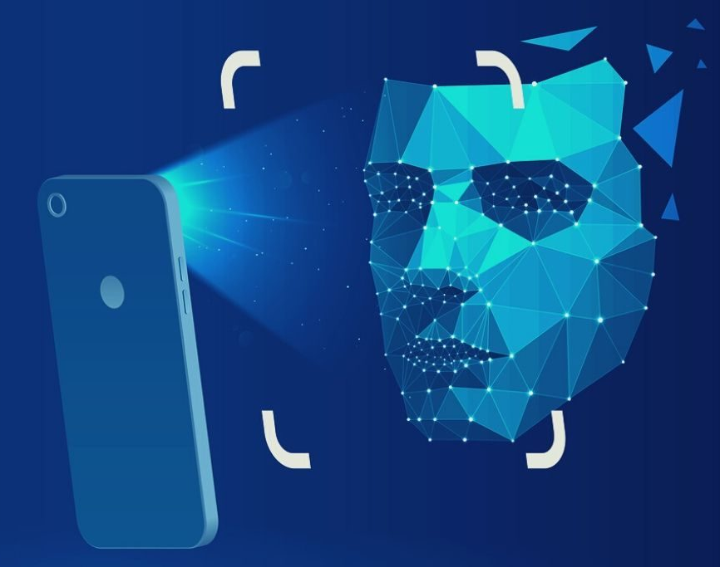
Face recognition and mask detection with attendance
BMS INSTITUTE OF TECHNOLOGY & M
UNDER THE GUIDANCE OF
Dr. ARUNKUMAR B R
Prof. RAVI KUMAR B N
FACULTY NAME - VISHAKHA YADAV
ODD SEMESTER:- Vth SEM

Slide 2
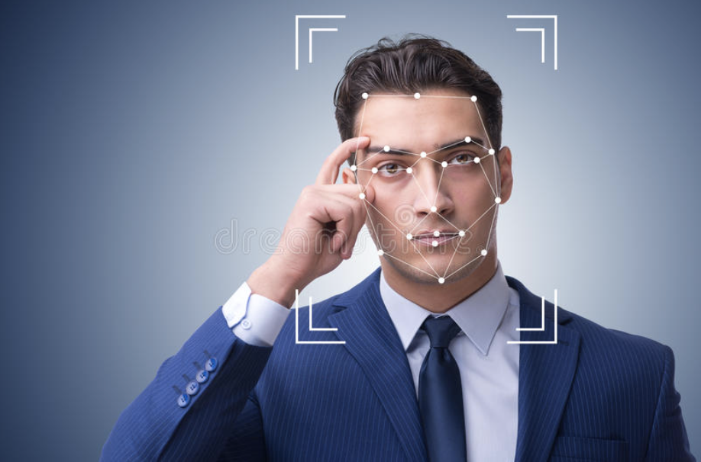
Contents
01
ABOUT PBL PROJECTS
02
PROBLEM SOLVER
03
LITERATURE SURVEY
04
SUBJECT MAPPING
05
OBJECTIVES
06
SYSTEM ARCHITECTURE
07
PROPOSED METHODOLOGY

Slide 3
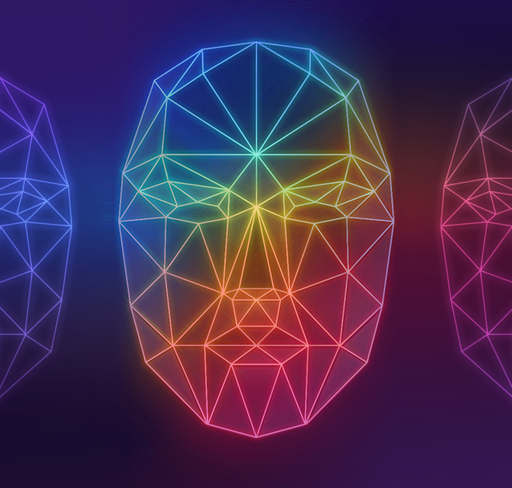
About PBL PROJECT
Our project emphasis on Trending Bio-Metric technology known to be as Face-Recognition and Mask Detection. We have created a Neuralink based project which Recognises individual Face Recognising along with telling that whether the Subjected person is wearing Mask or not.

Slide 4


Subject mapping
PYTHON
Computer network
PIPES (OPENCV, KERAS)
Imutils
sklearn.preprocessing
python loops in fetching image data and analysis.
Lists.
MobileNetV2
PROTOCOLS(TCP)
DATABASE (IMAGE META –DATA)
IMAGE STREAM TRANSFER PROTOCOL
FILE SEARCHING

Slide 5
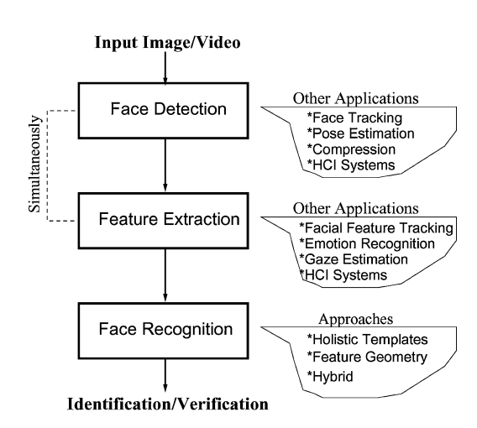
Literature survey
“The Expression of Emotion in Man and Animals” was written by Charles Darwin . This book greatly inspired the study of emotions. Emotion Recognition due to its various applications gained immense importance like a drowsy driver could be spotted using emotion recognition systems . They primarily talked about techniques and the parameters used for emotion recognition. The methods mentioned consisted of localization of the face using detection and segmentation, which made use of Support Vector Machine (SVM) and Convolutional Neural Networks (CNN) algorithms. Along with all these techniques, concentrated on the categorization for emotion recognition considering the two principal components, one was parametrization, and the other was recognition of facial expressions. In his research, parametrization was relating the emotions detected while recognition of facial expressions was accomplished by using the algorithms such as Viola and Jones.

Slide 6
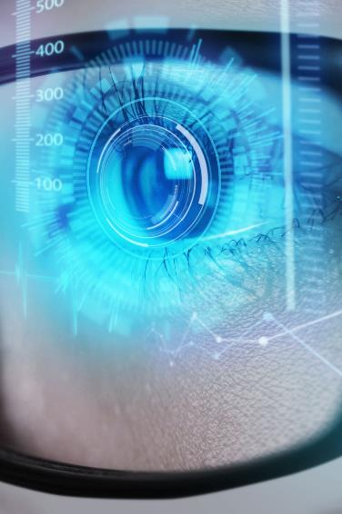
Problem Solver
Find the Missing
Crime
Financials Fraud
We can track can down the missing people. Even we can find the lost children even after 4-5 years or more.
By this system we detect Suspected Criminals and vigilantly. Potential Crime came be pulled down.
In ATM machine vigilantly can be track down by Face-recognition process and potential crime could be stopped by this.
Attendance
Mask detection
Covid-19 Era
While entering the class it will check mask and poll attendance of individual student or faculty.
This system could be used in detecting Mask in Hot-Spot area’s such as Airports, Malls, Crowed Market, Workplaces,
Current Situation Could be tacked down by Mask-Detection system . Helping and awaking people about Covid norms.

Slide 7
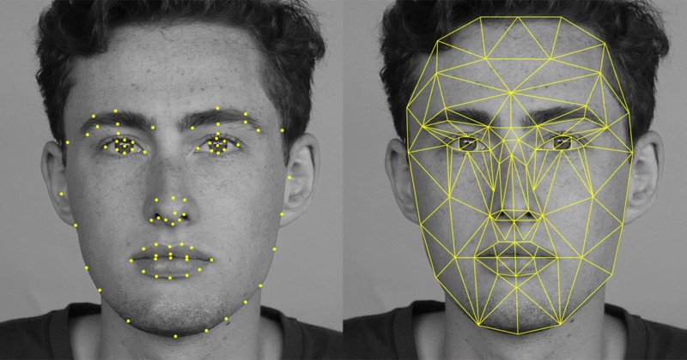
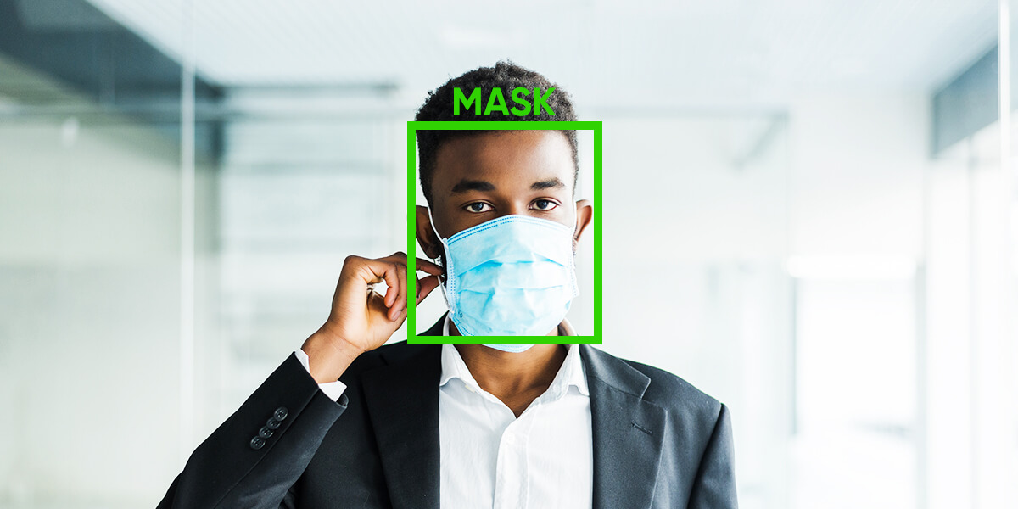
OBJECTIVEs
Face recognition has been one of the most interesting and important research fields in the past recognition, image processing, and machine learning, etc. A bunch of papers have been published to overcome difference factors (such as illumination, ex- pression, scale, pose, ……) and achieve better recognition rate, while there is still no robust technique against uncontrolled practical cases which may involve kinds of factors simultaneously. In this report, we’ll go through general ideas and structures of recognition, important issues and factors of human faces, critical techniques and algorithms. This report only focuses on color-image-based (2D) face recognition, rather than video-based (3D). two decades. The reasons come from the need of automatic recognitions and surveillance systems, the interest in human visual system on face recognition, and the design of human-computer interface and access control. These researches involve knowledge and researchers from disciplines such as neuroscience, psychology, computer vision and pattern recognition. The face detection algorithm involved color-based skin segmentation and image filtering. The face location was determined by calculating the centroid of the detected region.

Slide 8
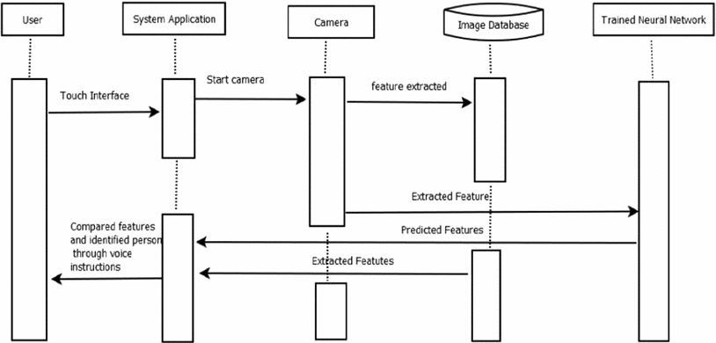
SEQUENCE DIAGRAM

Slide 9
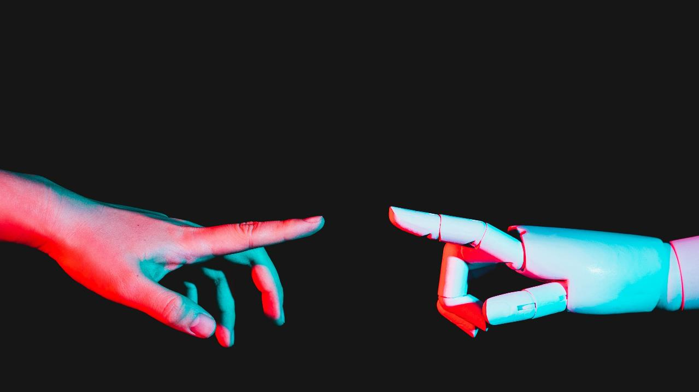
System architecture

Slide 10
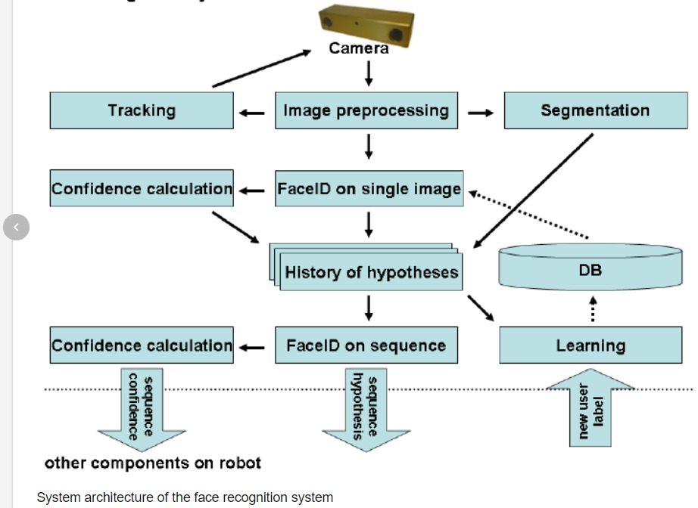
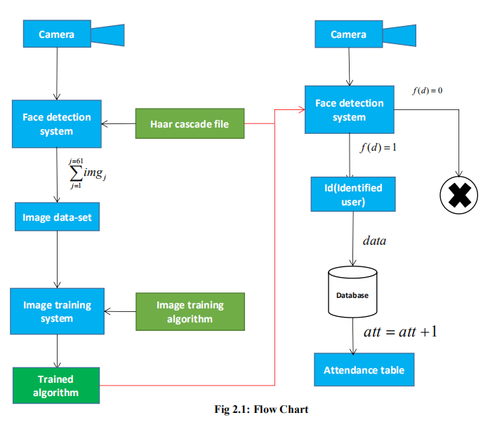
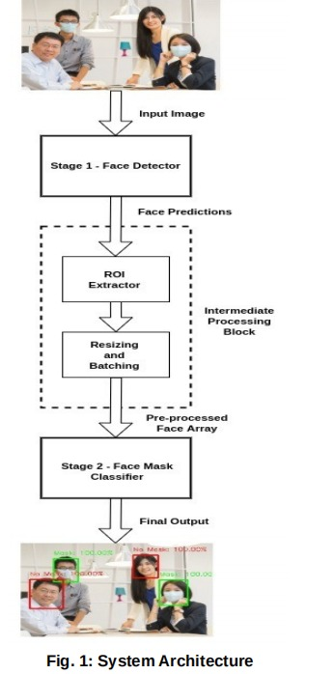
FACE RECOGNITION SYSTEM ARCHITECTURE
MASK DETECTION SYSTEM ARCHITECTURE

Slide 11
Proposed methodology
We propose a two-stage architecture for detecting masked and unmasked faces and localizing them. System Architecture represents our proposed system architecture (input image taken from the dataset It consists of two major stages. The first stage of our architecture includes a Face Detector, which localizes multiple faces in images of varying sizes and detects faces even in overlapping scenarios. The detected faces (regions of interest) extracted from this stage are then batched together and passed to the second stage of our architecture, which is a CNN based Face Mask Classifier. The results from the second stage are decoded and the final output is the image with all the faces in the image correctly detected and classified as either masked or unmasked faces.
Face Detector:
A face detector acts as the first stage of our system. A raw RGB image is passed as the input to this stage. The face detector extracts and outputs all the faces detected in the image with their bounding box coordinates. The process of detecting faces accurately is very important for our architecture. Training a highly accurate face detector needs a lot of labelled data, time, and compute resources. For these reasons, we selected a pre-trained model trained on a large dataset for easy generalization and stability in detection.

Slide 12
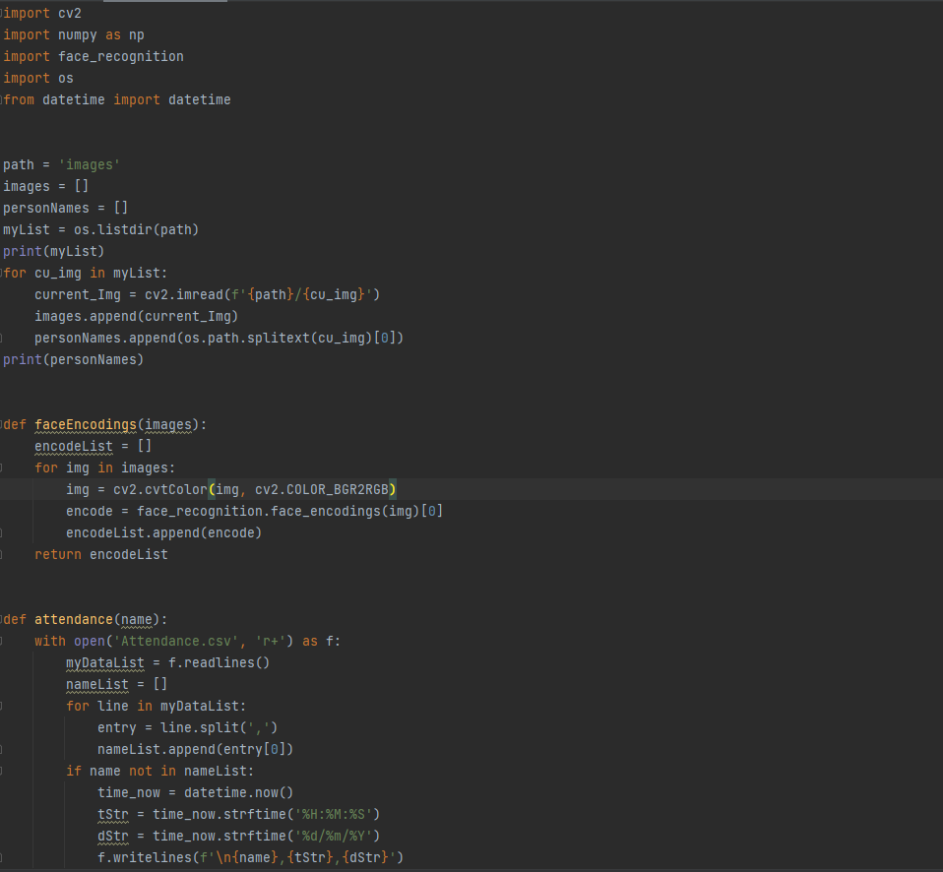
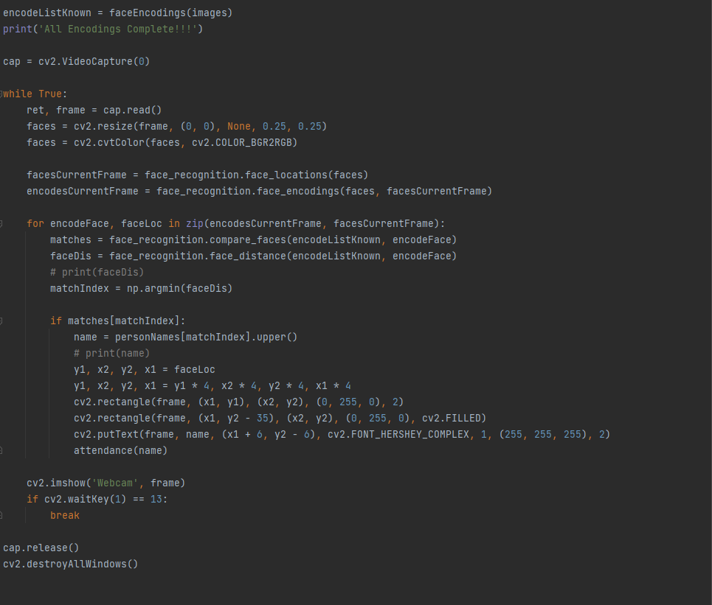
Face-Recognition Code

Slide 13
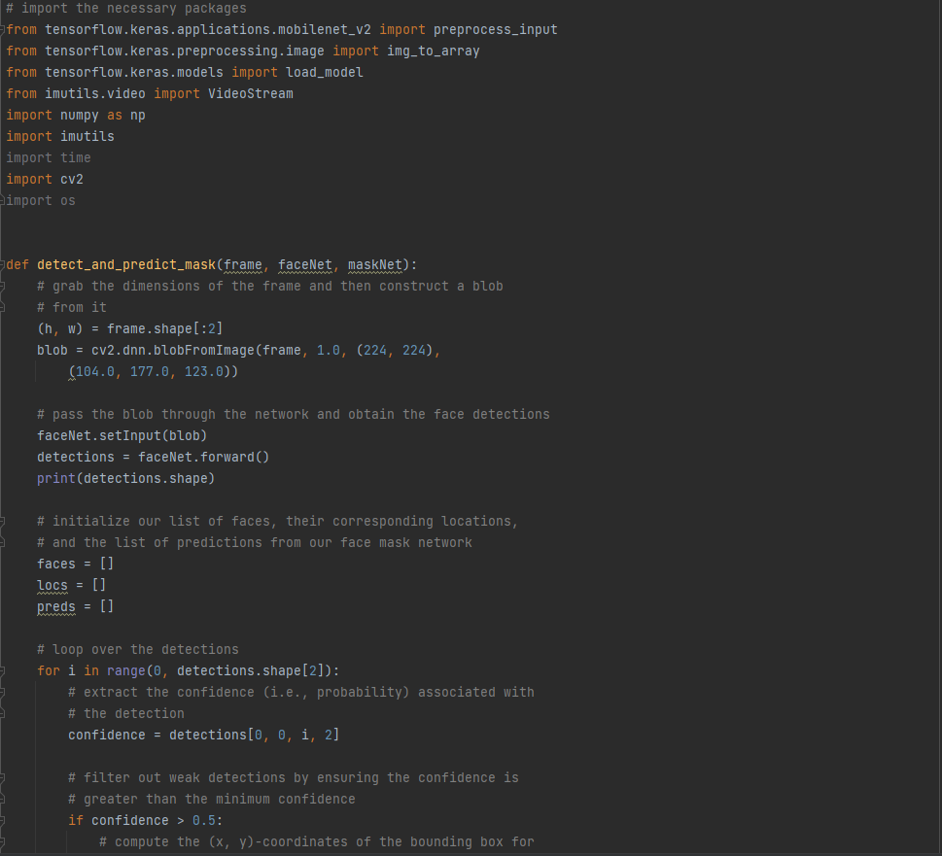
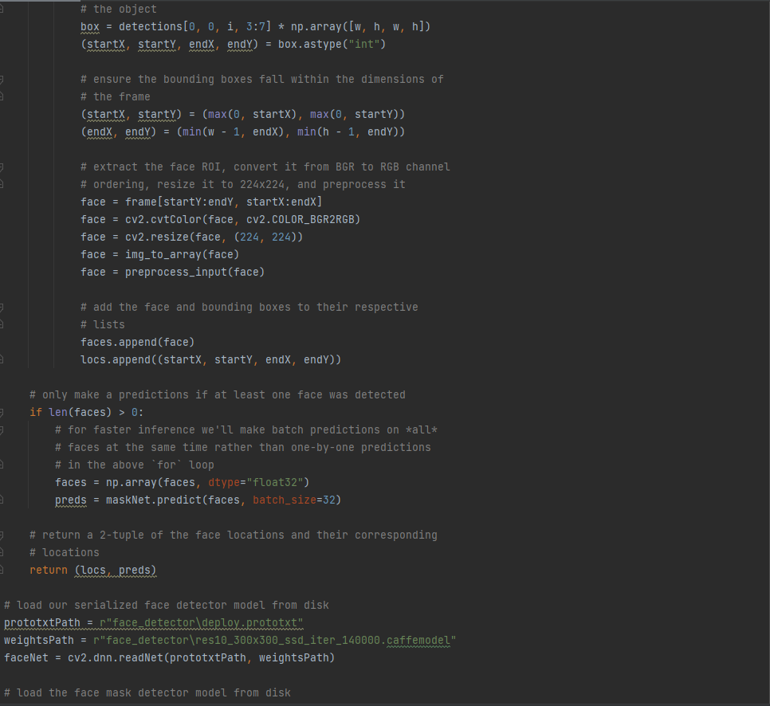
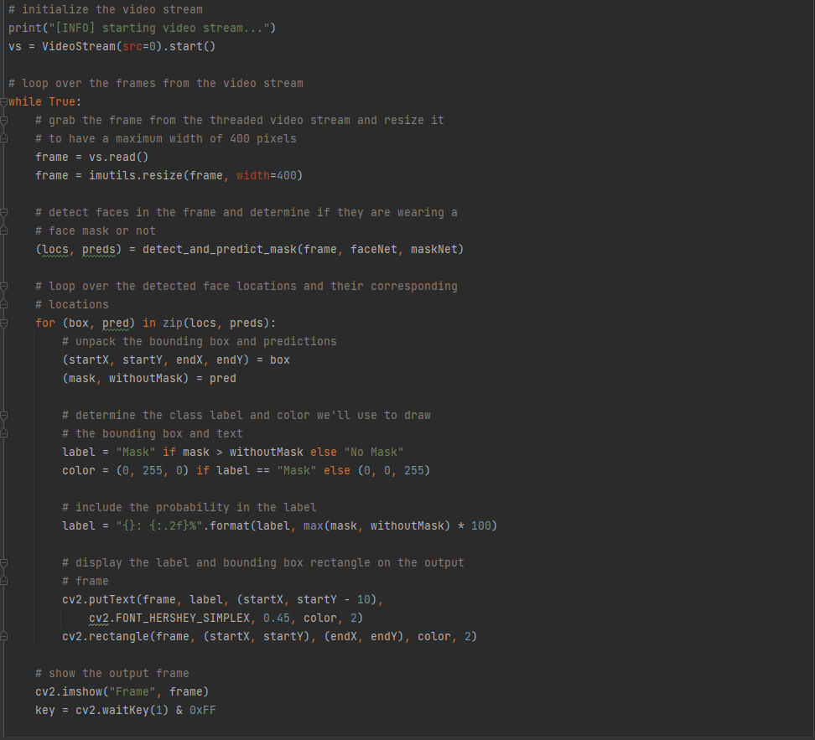
Mask-Detection Code

Slide 14
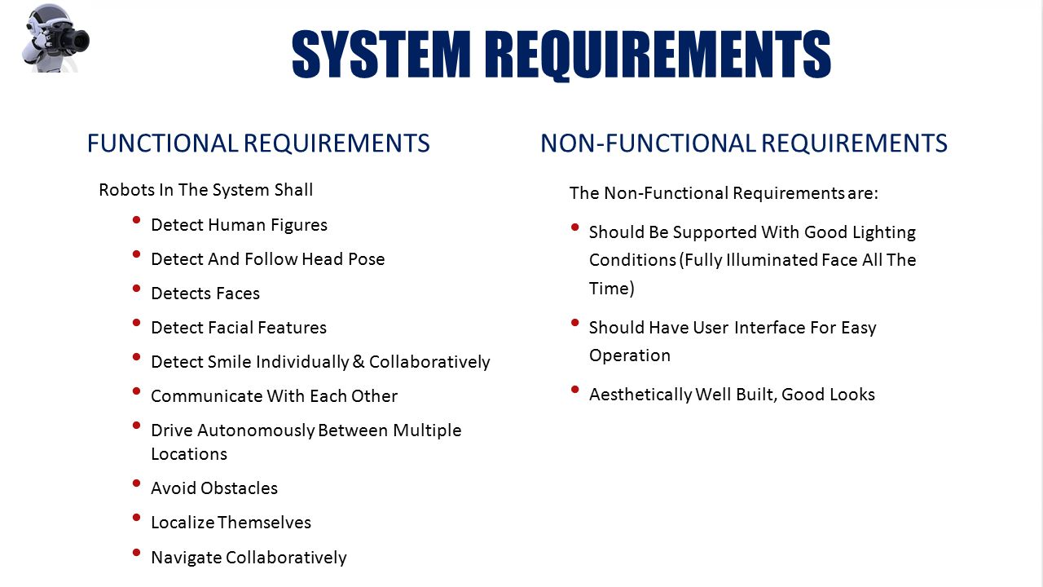

Slide 15
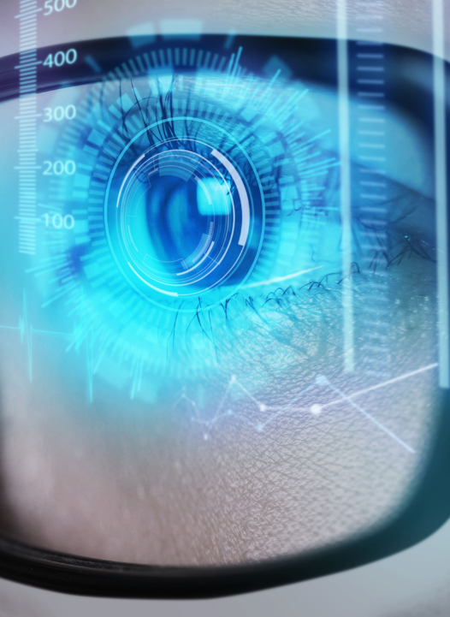
Summary
So, This prototype system allows for the facial recognition of people with and without a mask, and could be used as a low computational consumption proposal for personnel access control. The two models of this system are tested with images, thus achieving better precision and optimization for each model. The face of someone found in the database is successfully classified to provide the name tag and probability of success. The three stages of the system allowed for the relevant characteristics of a person’s face to be extracted, and thus use a simple neural network for the classification task. In this sense, the use of a “Face Embeddings” as input to the neural network obtained satisfactory results in the experiments carried out.

Slide 16
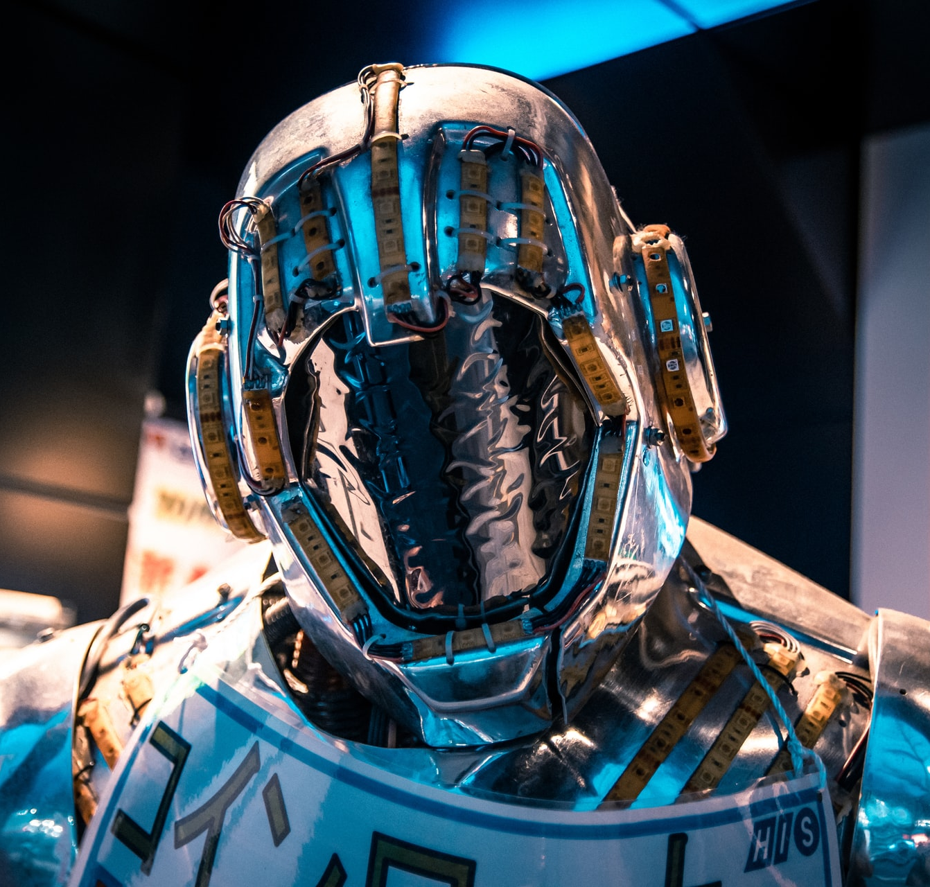
References
W3Schools
Codecademy
Stanford Engineering Everywhere
MIT OpenCourseWare
GitHub
Google
Geeks for geeks

Slide 17
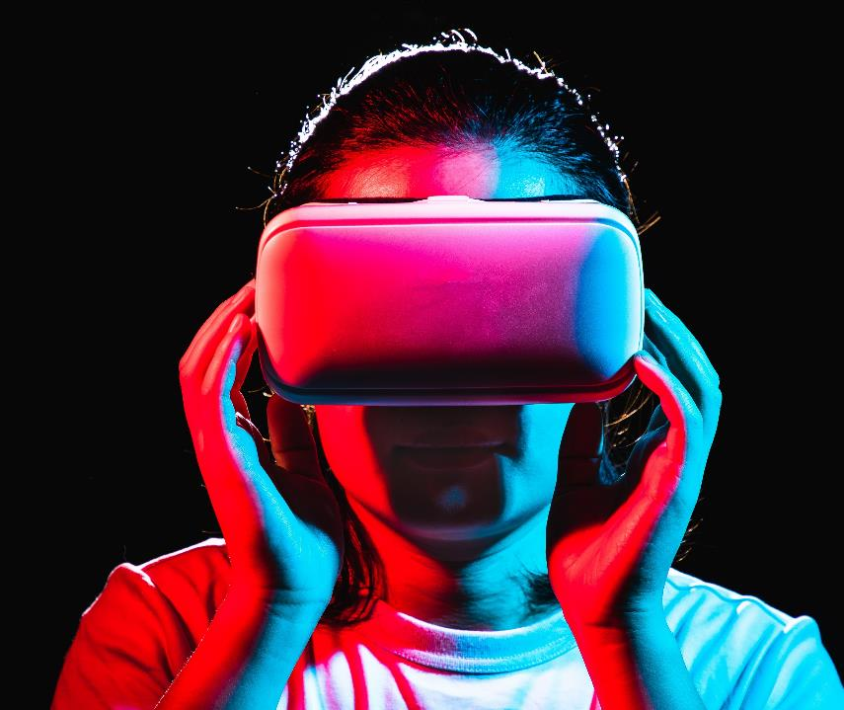
Thank you

